Slide 1

Water Logging Solution
smarter pipeline designing
Mitrasree Deb Mitra
( Department of CSE , BUET )
Dipto Barua
( Department of CSE, BUET )

Slide 2

Existing system problems
Old Drainage System : Based on the road networks in the city.
Ever-changing face of Dhaka’s roadway leading to more unutilized , over-used and mostly ill-used drainage.
Lack of dynamism of the drainage system for coping with the ever-growing population.
Both the peoples and governments lack of care for the existing drainage system leading to deteriorated and misused drains.
Accommodation for more and more people leading to more households yet less drainage.
Clogging of trash and other junks inside the drainage system.
Damages from the rains and flooding in the monsoon season . More trash and unwanted objects getting piled up inside the main drains.

Slide 3
Our Solution
Collecting data from the users of the application . Data such as :
Calculating total volume of the water body inside a particular area.
Observing data from the water logged areas and predicting their change over the course of several years.
Design a new drainage system that can cope with other predicted changes for a long time. A design capable of providing suggestions for change in the road networks, also get rid of maximum amount of water from the city.
Smartly connecting the existing and predicted water logged areas and designing pipeline connections among them so that maximum amount of water can be extracted and least amount of resources used.
Match our results and cross-reference with the existing road and drainage system of the city providing best fit such that it ensures less execution problems and resource loss.
Generate highly endangered areas from the complaint lists and provide sufficient help in those areas.
Water level ( Custom or option based )
Exact position ( Latitude and longitude )
Duration of logging in that position ( Optional )
Algorithms : Convex hull for area generation
Ford Fulkerson for maximum flow calculation

Slide 4
Mobile Interface
collecting user data

Slide 5
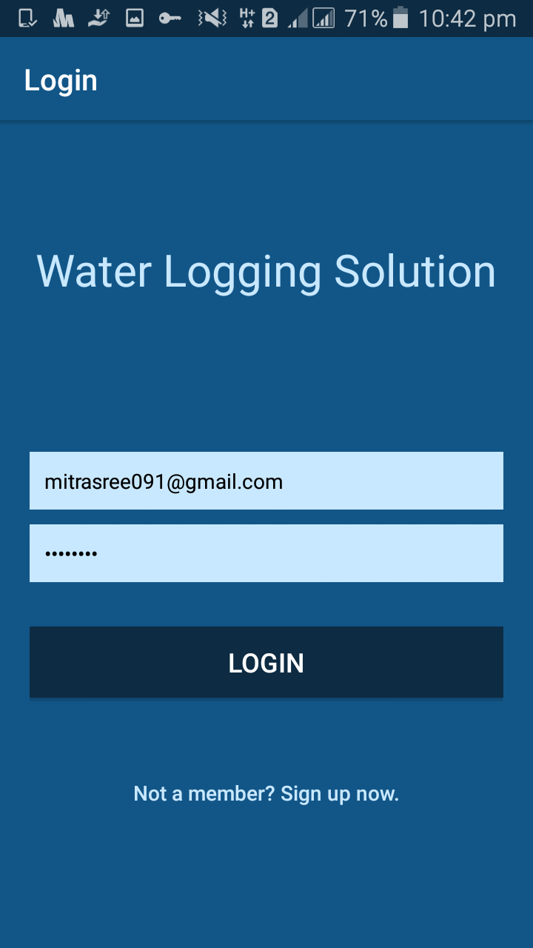
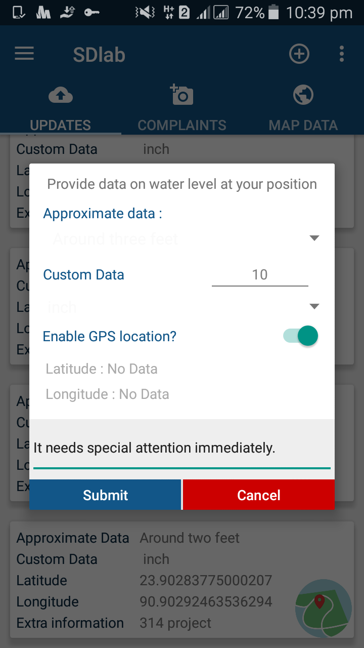
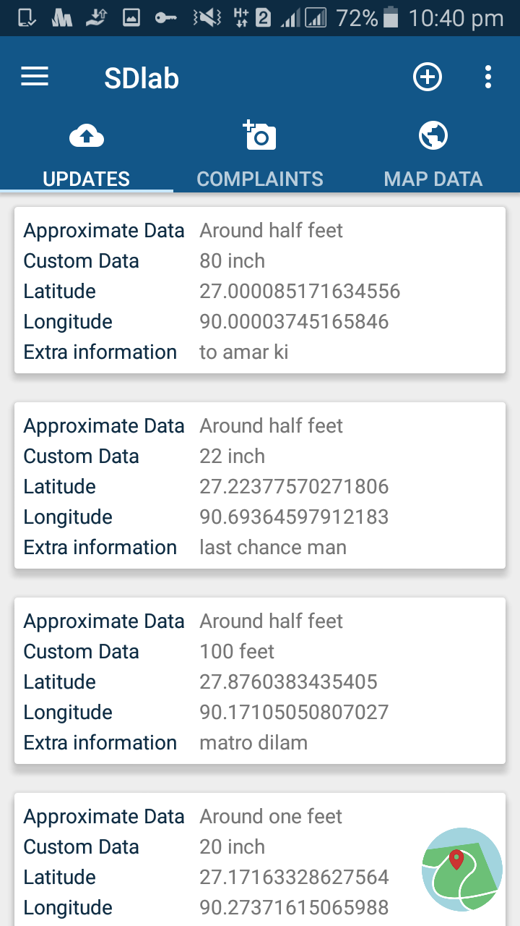
Mobile Interface

Slide 6
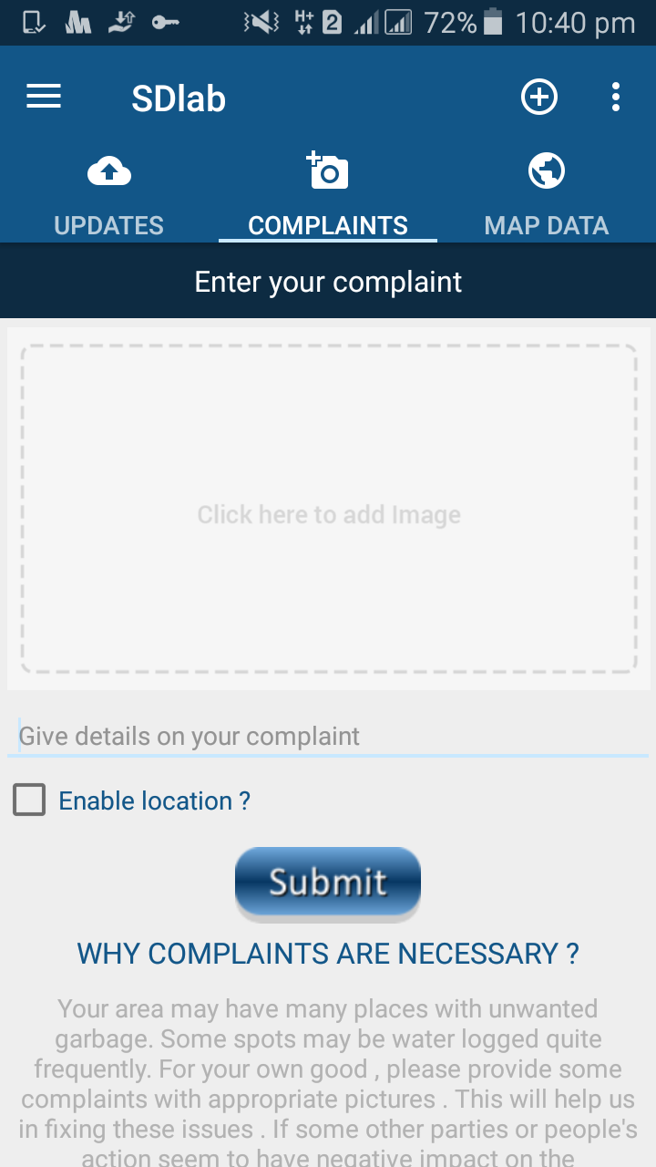
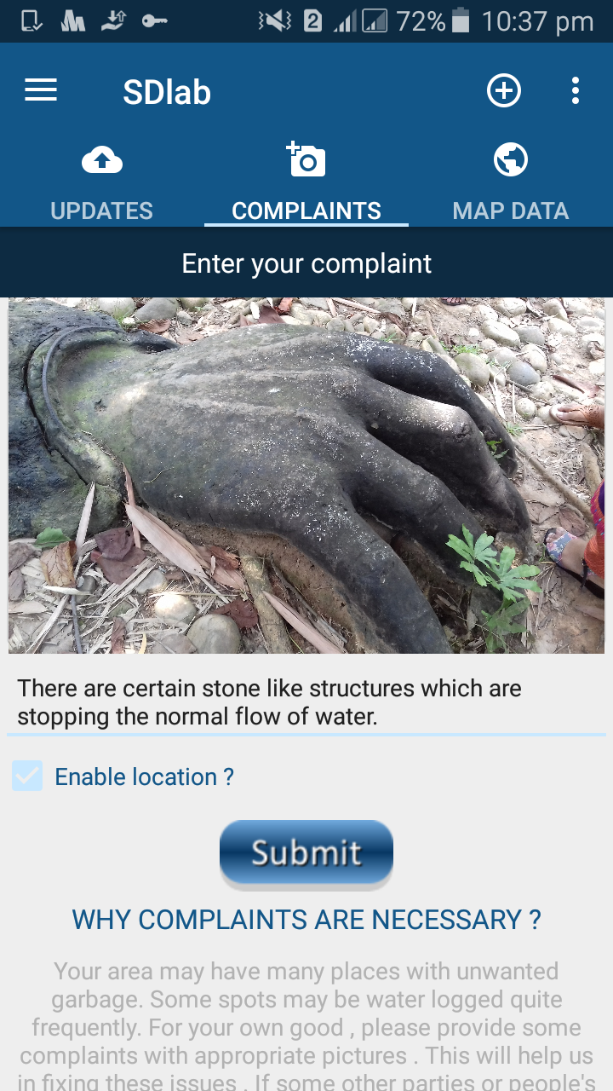
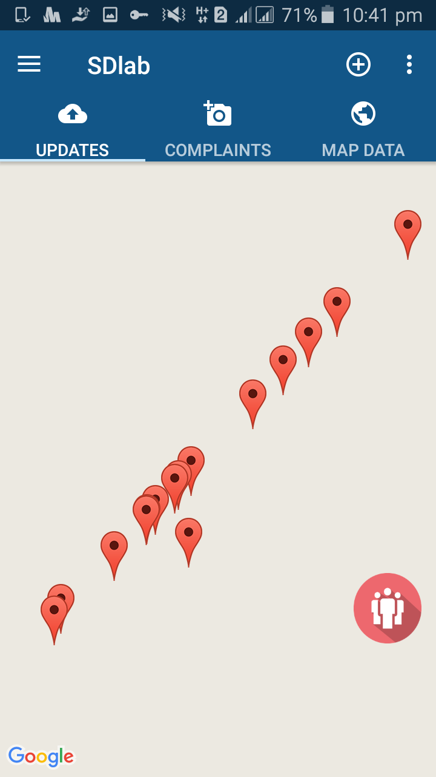

Slide 7
Desktop software Interface
Designing pipelines

Slide 8
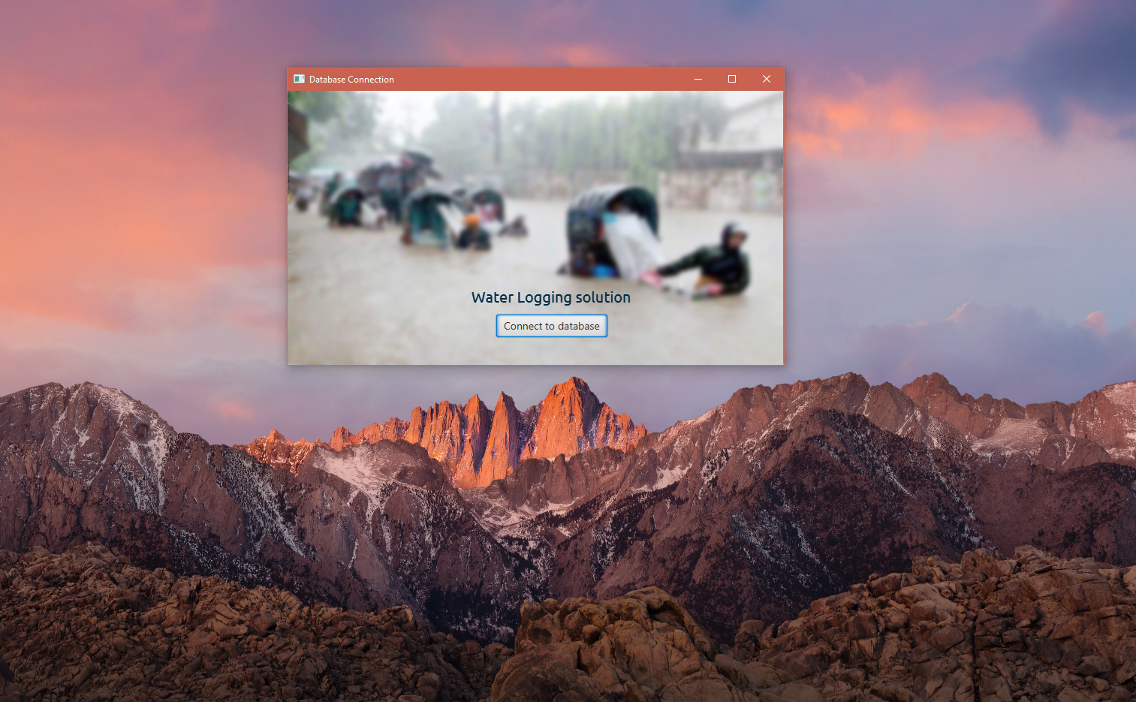

Slide 9
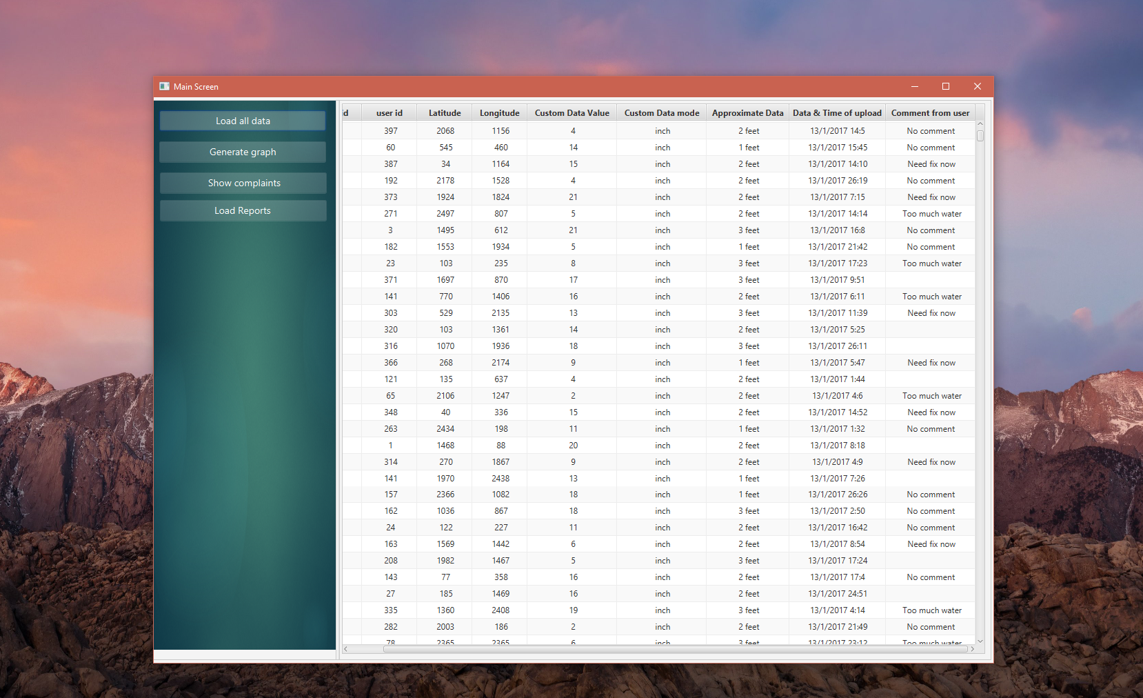

Slide 10
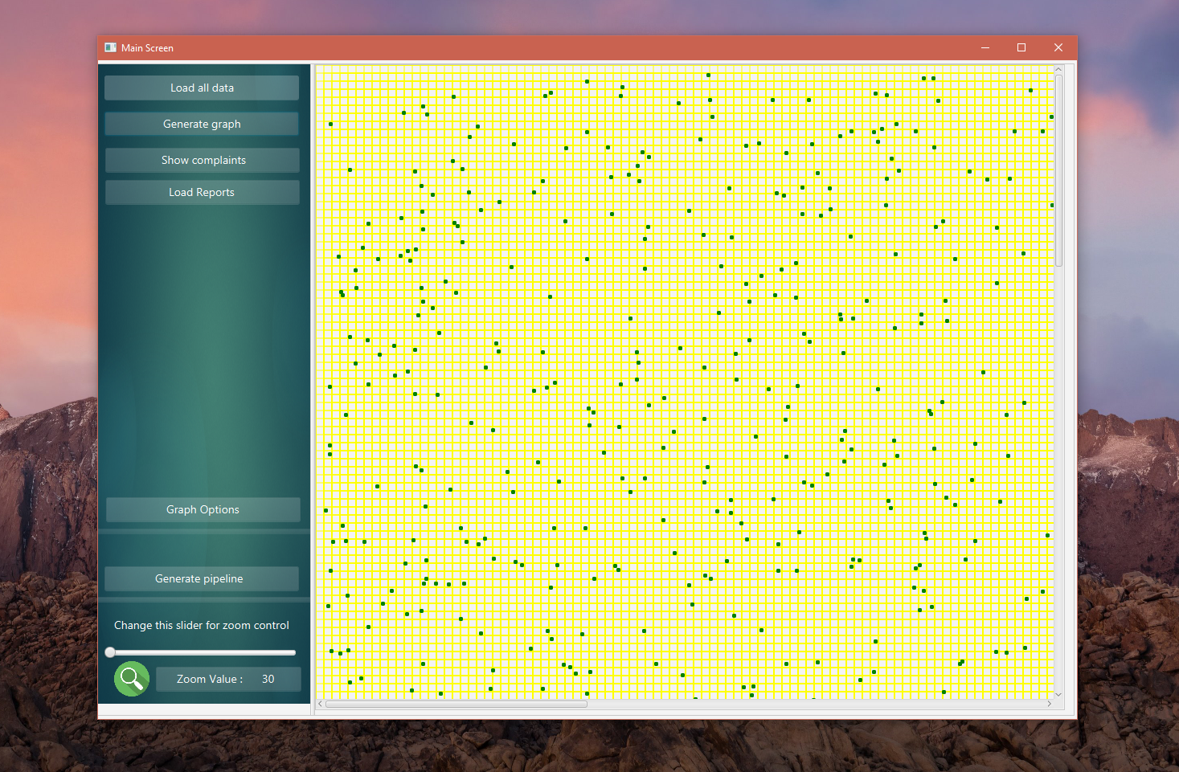

Slide 11
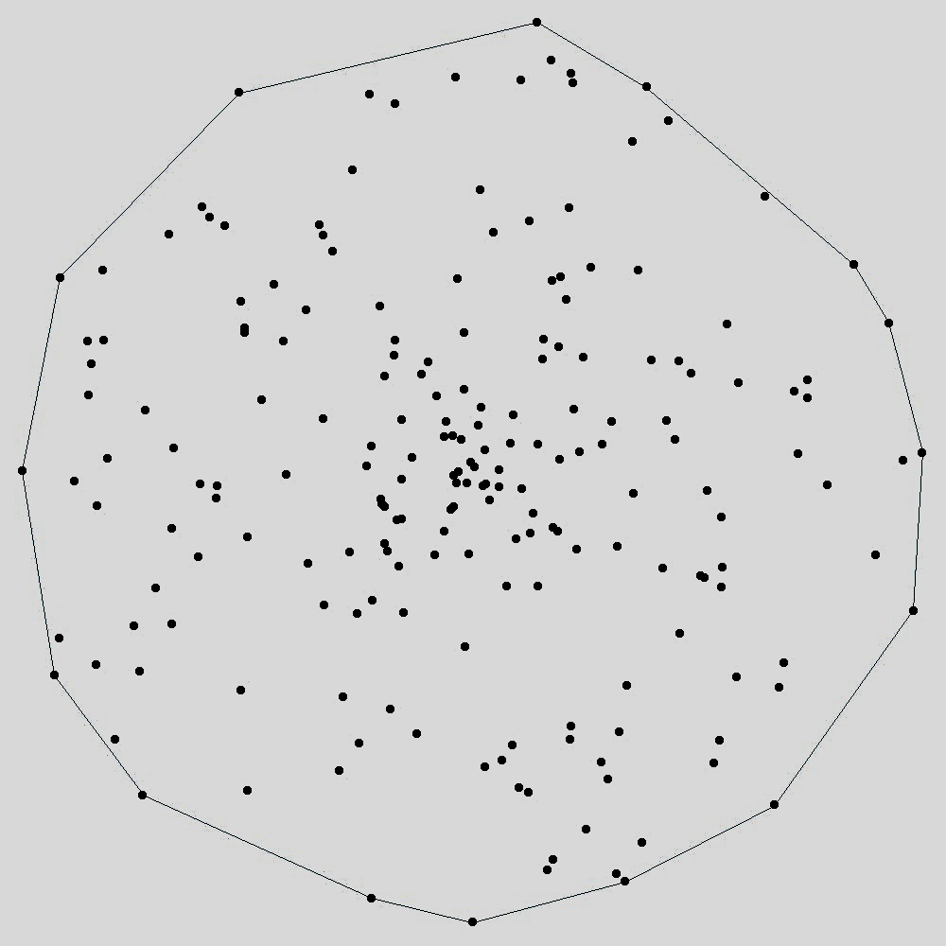
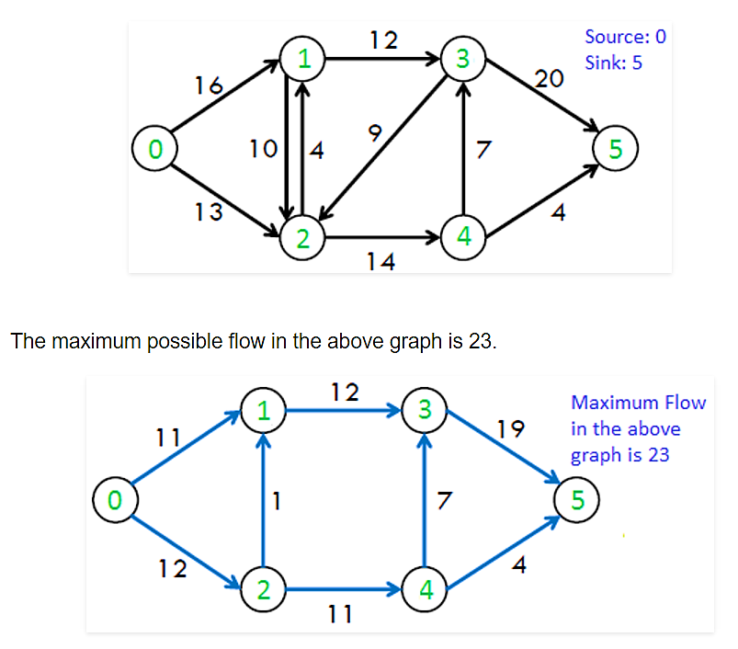
Applying convex hull algorithm to find boundary of a certain area.
Applying max-flow algorithm on convex hull generated areas for max flow

Slide 12
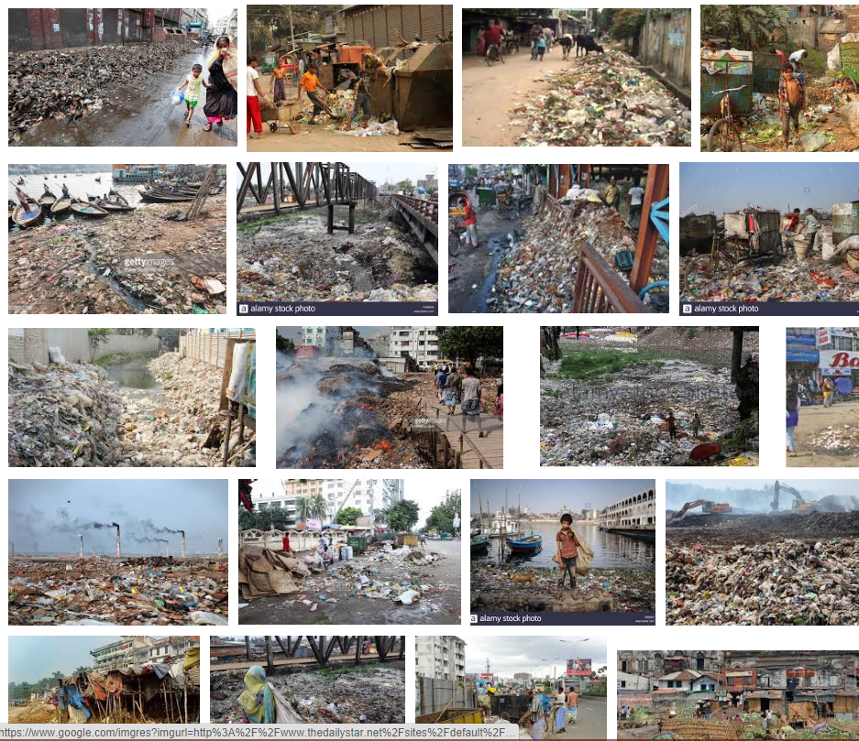
Complaints List

Slide 13


